Slide 1


Slide 2
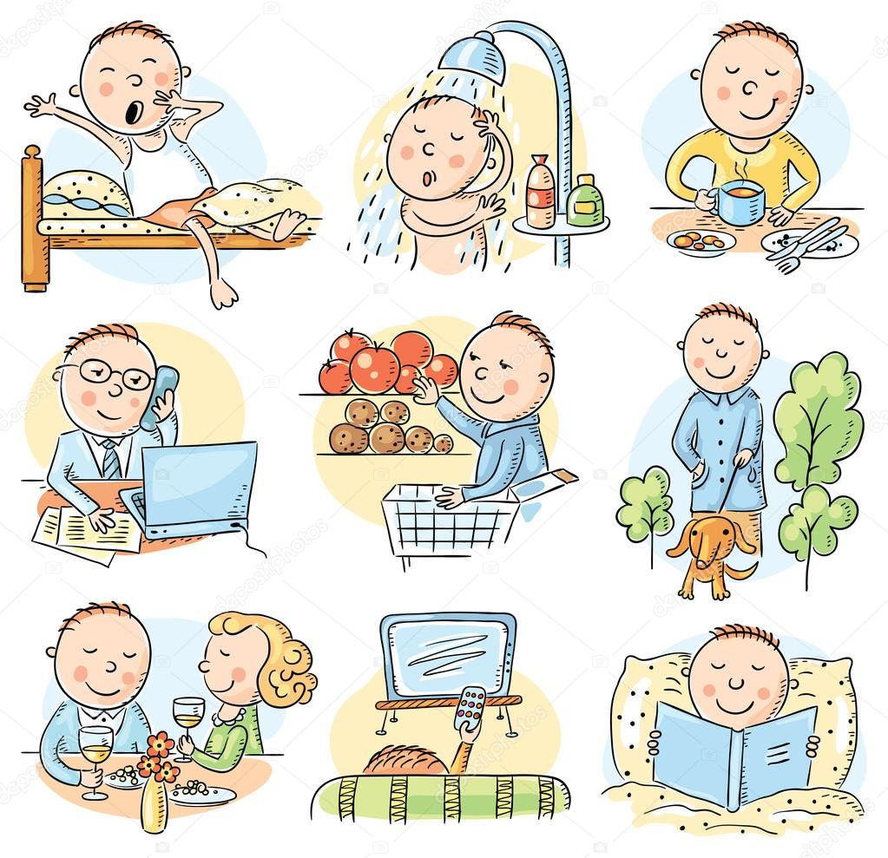

Slide 3

Daily Routine

Slide 4
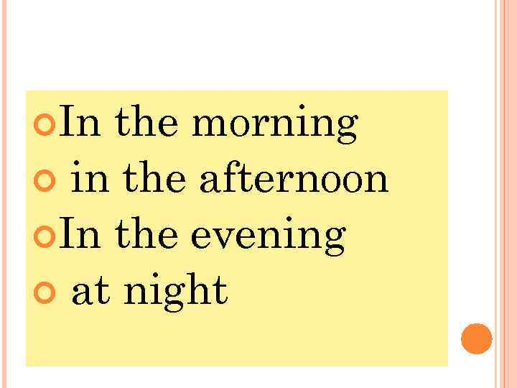

Slide 5
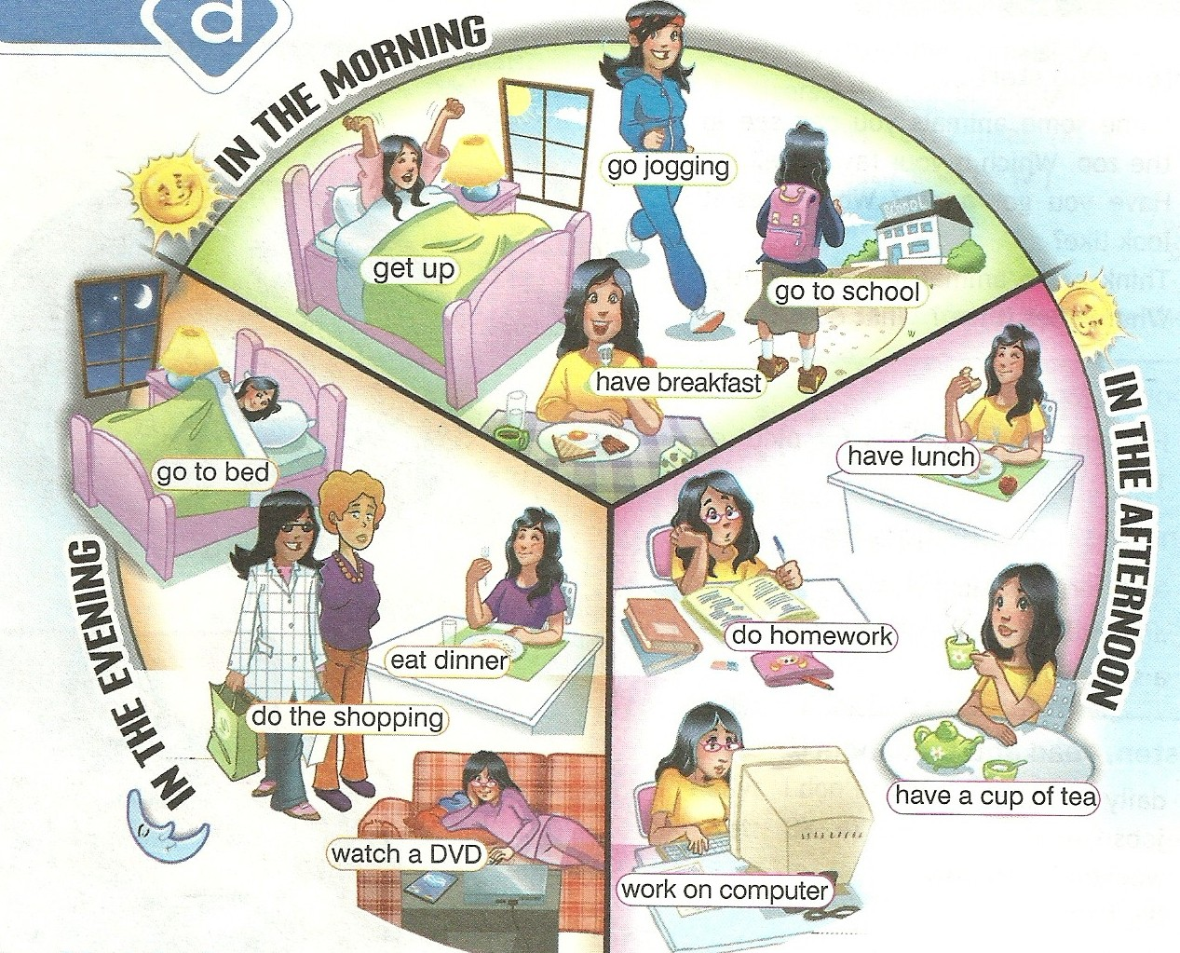

Slide 6
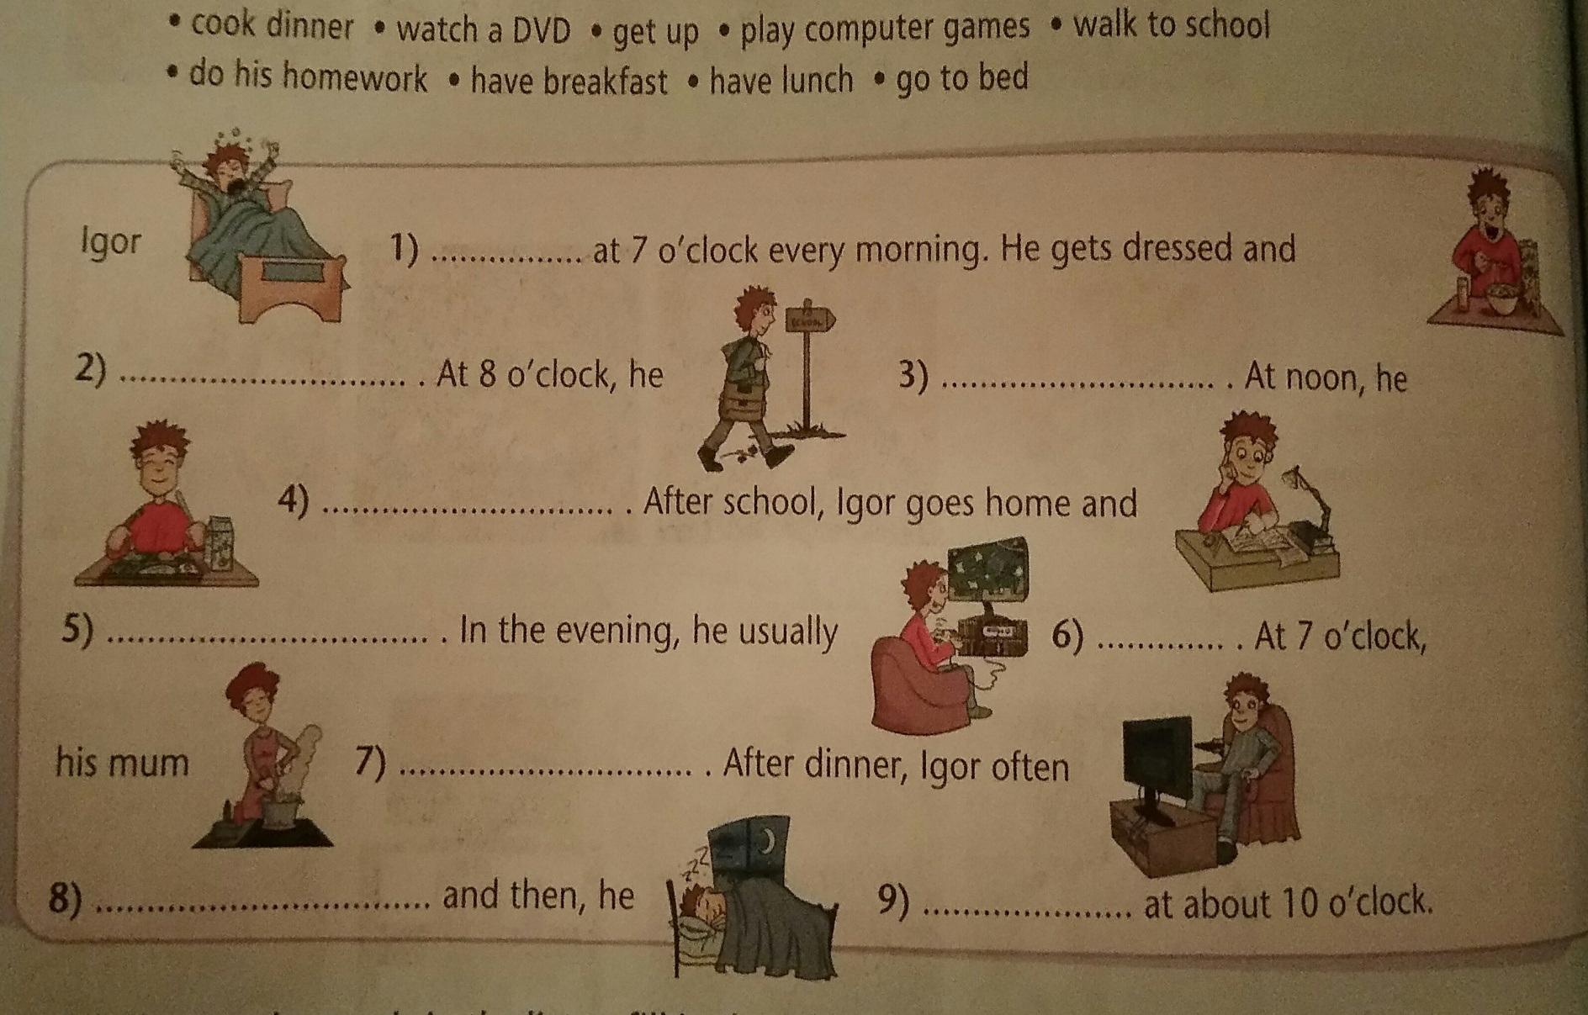

Slide 7
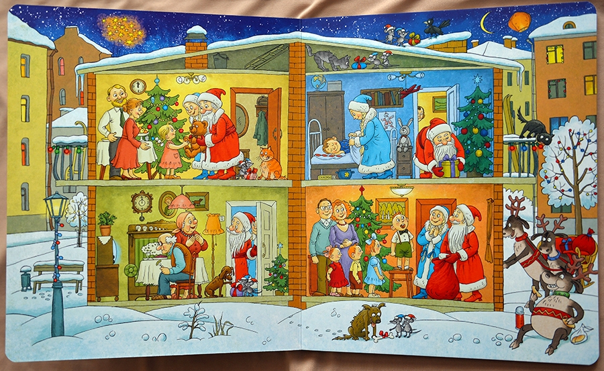
Homework
Presentation: “One day in the life of…(your favourite character) ~ Santa ;) ”

Slide 8
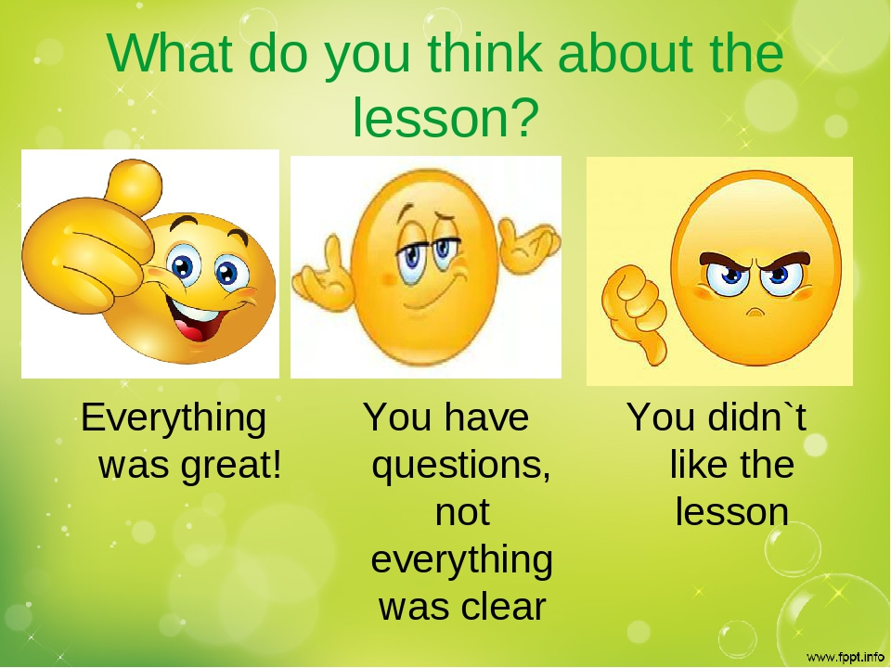

Slide 9


Slide 10
Ресурсы для работы на интерактивной доске: https://quizlet.com/_5rsf93 https://learningapps.org/5921206

